Slide 1
CUSTOMER ANALYSIS PROJECT—with python
TARGETING SPECIFIC CUSTOMER SEGMENT FOR NEW PRODUCT MARKETING?
Patience Gihozo

Slide 2

Outline
Problem statement
Project focus
Dataset
Data preparation
Analysis
Insights
Conclusions

Slide 3
Outline
Problem statement
Project focus
Dataset
Data preparation
Analysis
Insights
Conclusions

Slide 4

Problem statement
A store/supermarket has a large database. It would be a waste of resource to advertise to every single customer or customer segment present in their database. However, exploring relationship between a certain product and other factors like how big is the customer’s family, how old are the individuals in the family, spending level, income,… might reveal what customer segment to target while advertising

Slide 5
Outline
Problem statement
Project focus
Dataset
Data preparation
Analysis
Insights
Conclusions

Slide 6

Project focus
There are many problems someone could ask themselves with this dataset. However, it is not possible to answer all of them. Hence, picking one focus would be ideal.
For this project I will focus on the relationship between meat consumption and various customer segments.

Slide 7
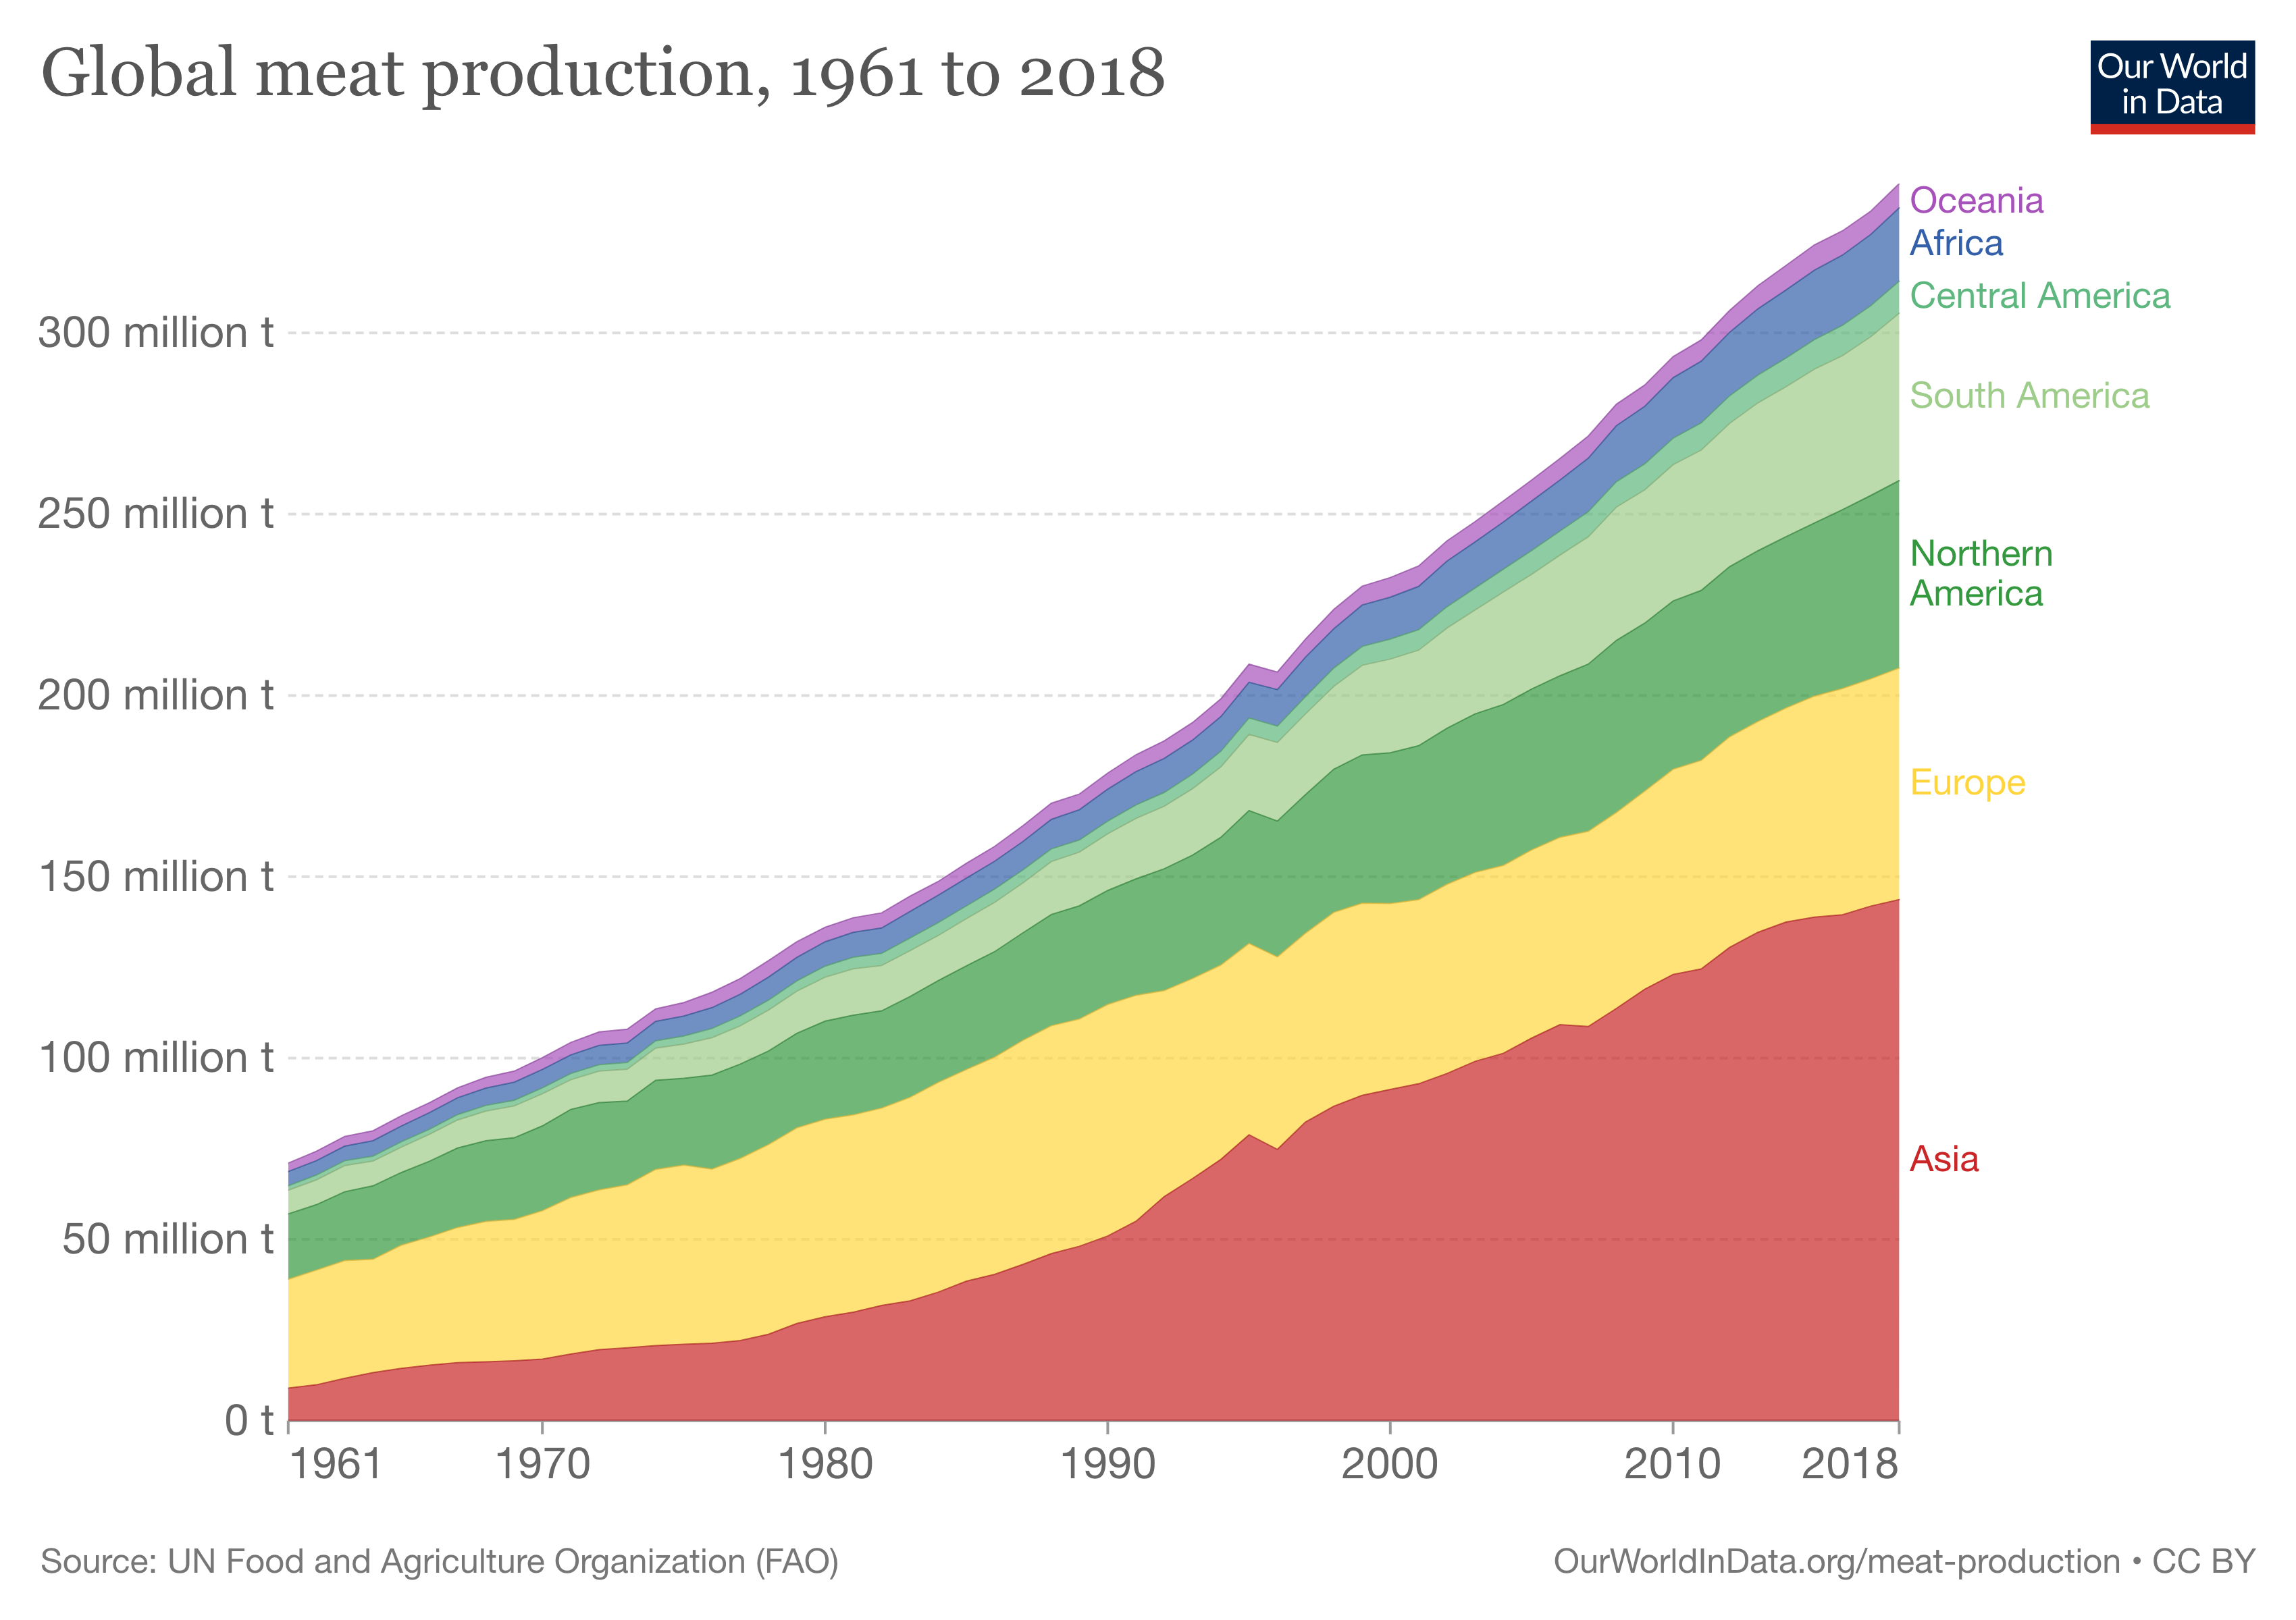
Why focus on Meat?
According to USDA, Between 1961 and 2018, annual meat production increased by over 30 million tonnes, representing an increase of 184%.
Red meat—meaning cows, pigs, and baby cows and lambs—accounted for just over half the total meat consumption

Slide 8
Outline
Problem statement
Project focus
Dataset
Data preparation
Analysis
Insights
Conclusions

Slide 9
ABOUT THE DATASET
I got the dataset from Kaggle
It is a dataset with 2240 observations and 29 variables
It was a supermarket that recorded information about their customers over time
They assigned each customer(family/single) with unique ids
They kept updating variables like what they buy, how much they buy, etc

Slide 10
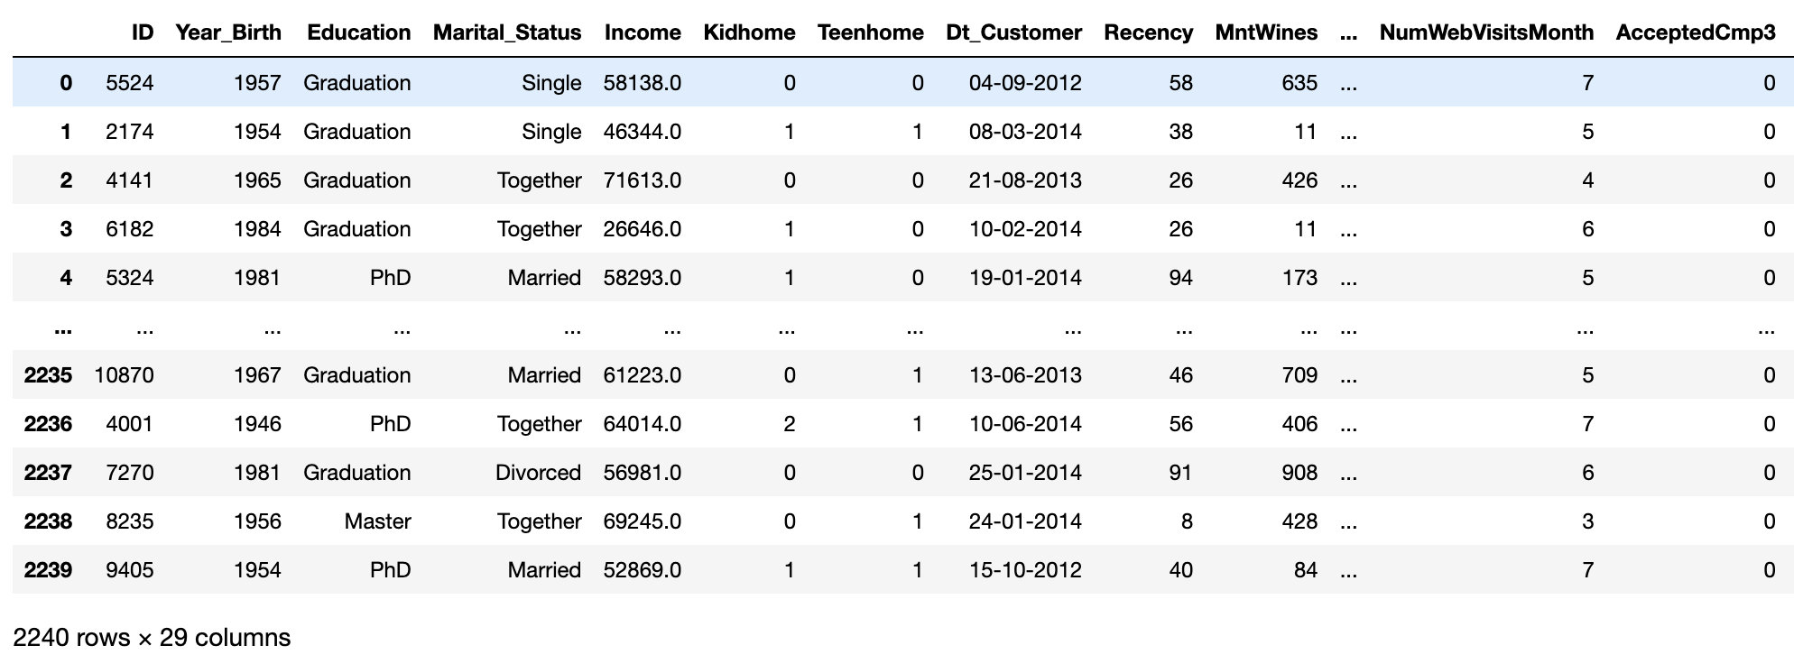
Overall look on the data

Slide 11
A complete list of all columns (Variables)
ID
Year_Birth
Education
Marital_Status
Income
Kidhome
Teenhome
Dt_Customer
Recency
MntWines
MntFruits
MntMeatProducts
MntFishProducts
MntSweetProducts
MntGoldProds
NumDealsPurchases
NumWebPurchases
NumCatalogPurchases
NumStorePurchases
NumWebVisitsMonth
AcceptedCmp3
AcceptedCmp4
AcceptedCmp5
AcceptedCmp1
AcceptedCmp2
Complain
Z_CostContact
Z_Revenue
Response

Slide 12
Outline
Problem statement
Project focus
Dataset
Data preparation
Analysis
Insights
Conclusions

Slide 13
Data preparation
I should have plotted the data to take a look before starting the analysis, but I don’t need all the variables.
I will use meat, age, education level, income, total spending, children and marital status.
I will remove NAs
Then plot the data before moving further

Slide 14
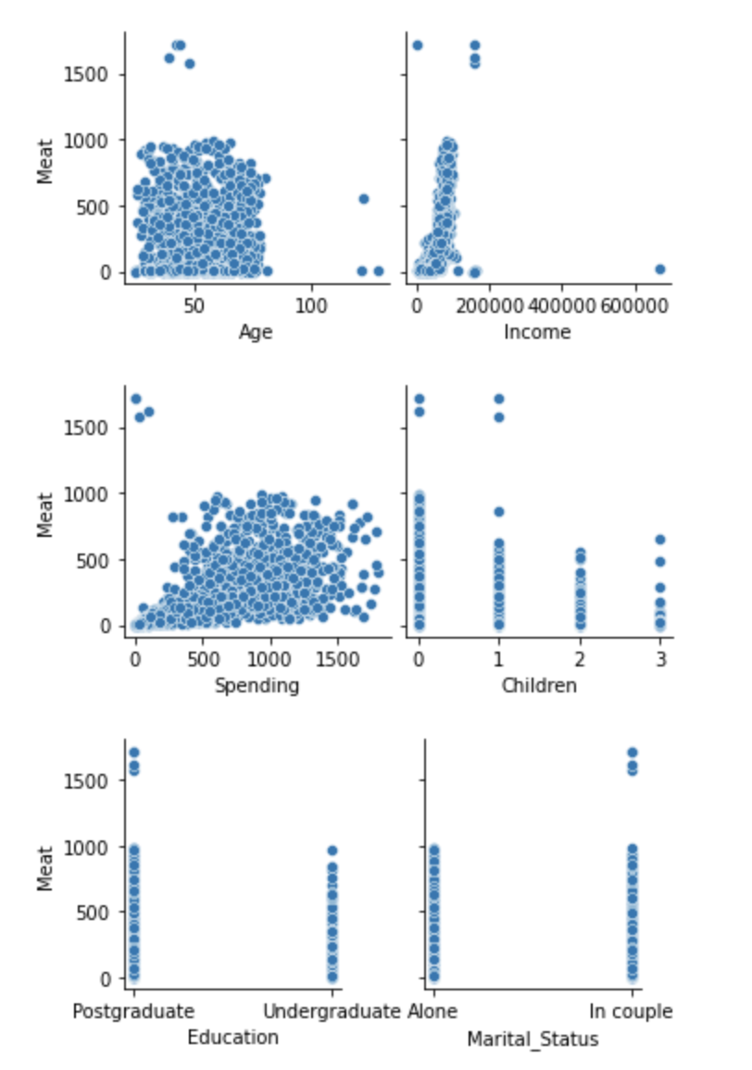
Graph of Meat consumption against other variables
There are outliers that need to be addressed for Meat, Age and Income

Slide 15
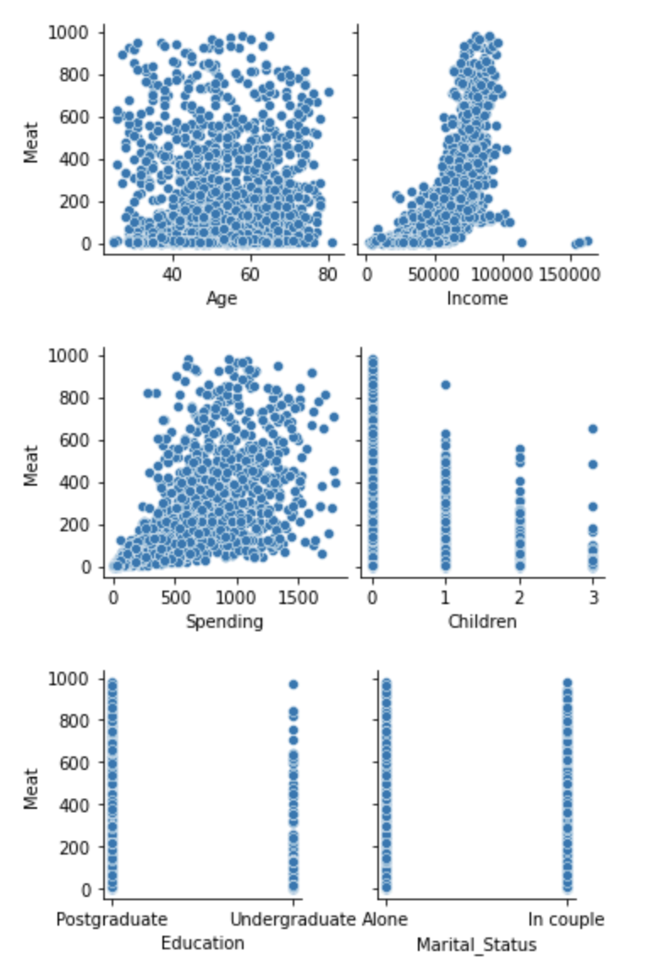
Graph of Meat consumption against other variables
After removing outliers
Education and marital status categories have no remarkable difference in regard their relationship with red meat consumption

Slide 16
Outline
Problem statement
Project focus
Dataset
Data preparation
Analysis
Insights
Conclusions

Slide 17
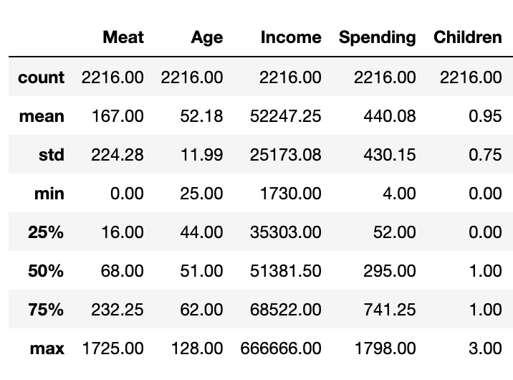
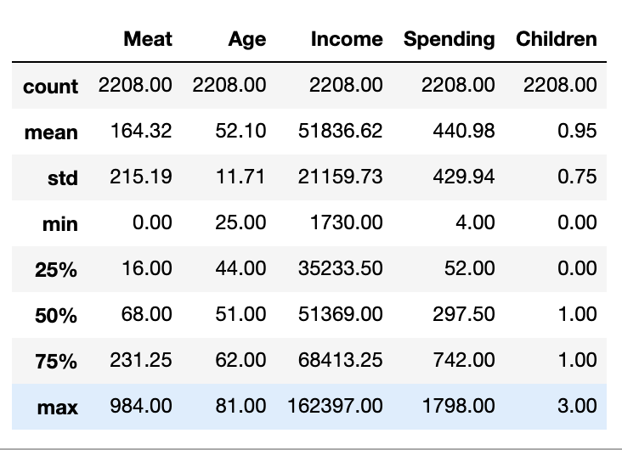
Statistical analysis
Data description before removing outliers: Data description after removing outliers:

Slide 18
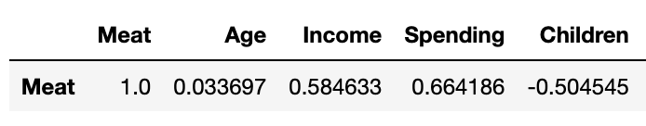
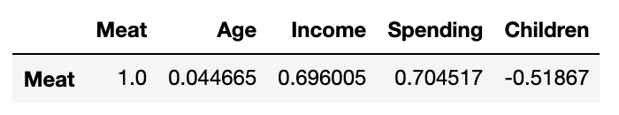
Statistical analysis
Correlation before removing outliers: Correlation after removing outliers:
According to Magoosh Statistics:
Generally, a value of r greater than 0.7 is considered a strong correlation. Anything between 0.5 and 0.7 is a moderate correlation, and anything less than 0.4 is considered a weak or no correlation.
Interpretation:
On average, as the number of children increases by 1, red meat consumption decreases by half in their family.
FYI: an example of one interpretation.

Slide 19
Outline
Problem statement
Project focus
Dataset
Data preparation
Analysis
Insights
Conclusions

Slide 20
Insights
A negative correlation between meat consumption and the number of children in the family
A positive correlation between meat consumption and income level
A positive correlation between meat consumption and spending level

Slide 21
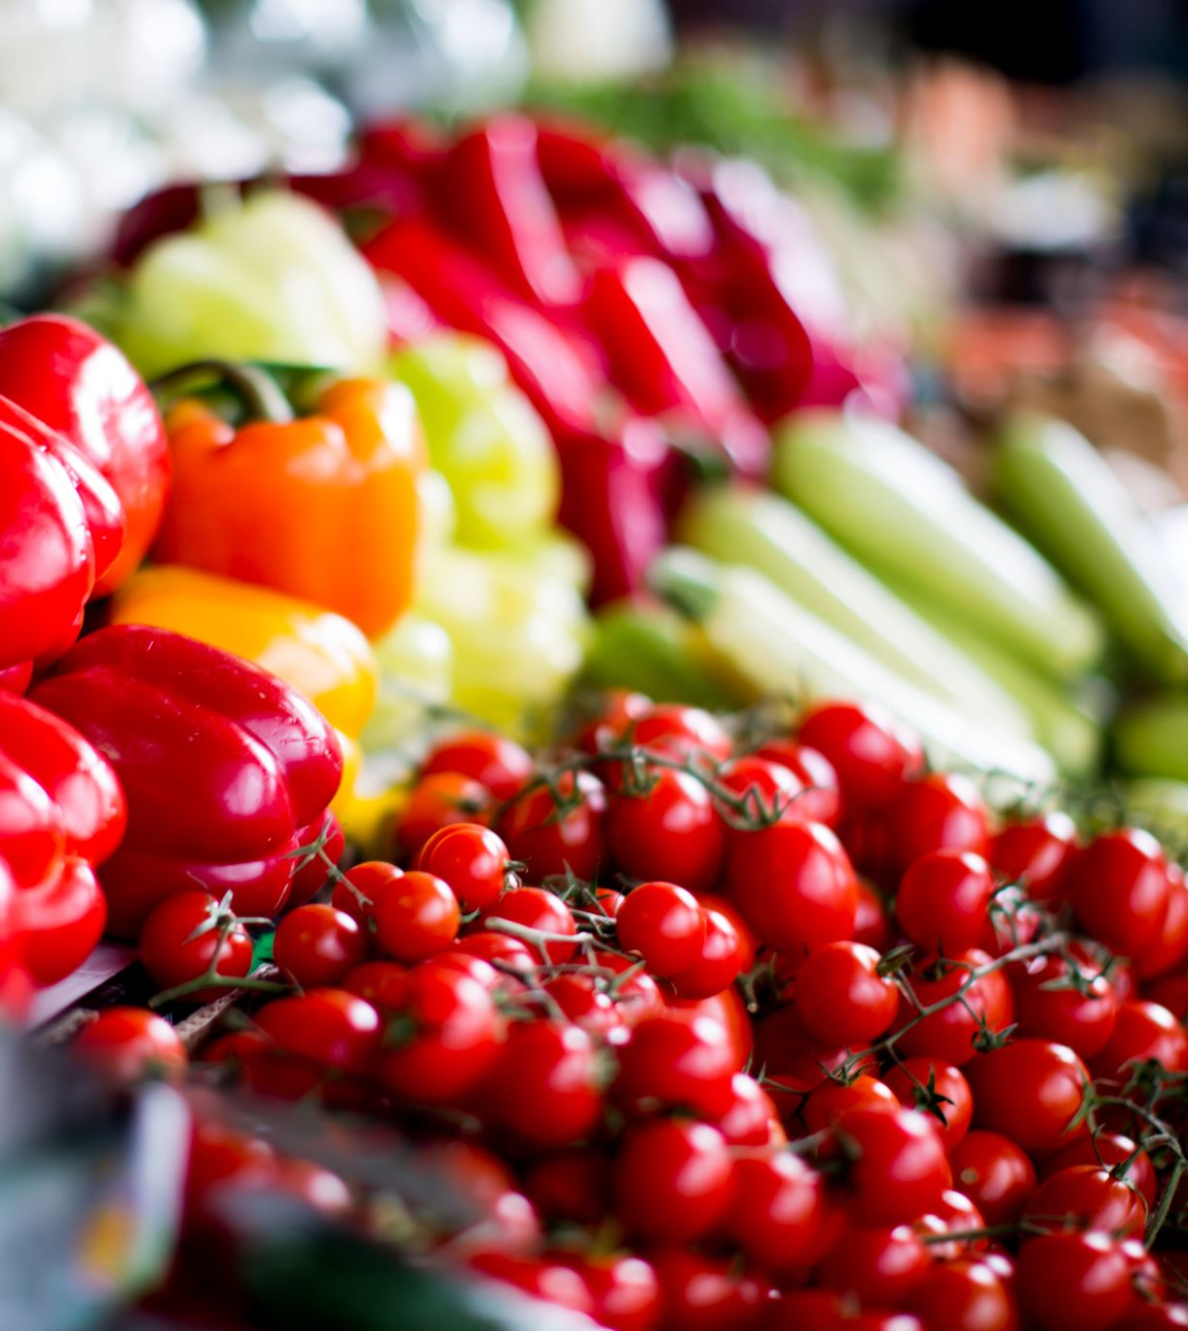
Number of children and meat consumption
According to Babylino(Children’s care website):
  How often should a child consume red meat
  “In conclusion, when the weekly diet of a child includes 2 fish meals, 1 chicken meal (or vice versa), 1 legume meal, 1 pasta meal and 1 vegetable casserole meal, there is only one meal left for red meat, per week. If for certain reasons, require the consumption of meat can be increased or decrease accordingly”
“This study provides clear evidence that regular consumption of red meat, especially processed meat, contributes substantially to premature death,” Frank Hu, professor of nutrition and epidemiology at the Harvard School of Public Health, told the university newspaper.
Myth about meat consumption without research is another factor

Slide 22
Outline
Problem statement
Project focus
Dataset
Data preparation
Analysis
Insights
Conclusions

Slide 23
Conclusion
There is no evidence for a strong relationship between meat consumption and customers’ education level or marital status
As the number of children increases, parents tend to reduce how much red meat they consume at home
Customers’ income level increases with how much they spend on groceries and how much red meat they buy as well
FYI: indication of a relationship between two variables doesn’t conclude that one is the cause of the other. Because there is no evidence of complete independence between variables.

Slide 24
Questions?

